Slide 1
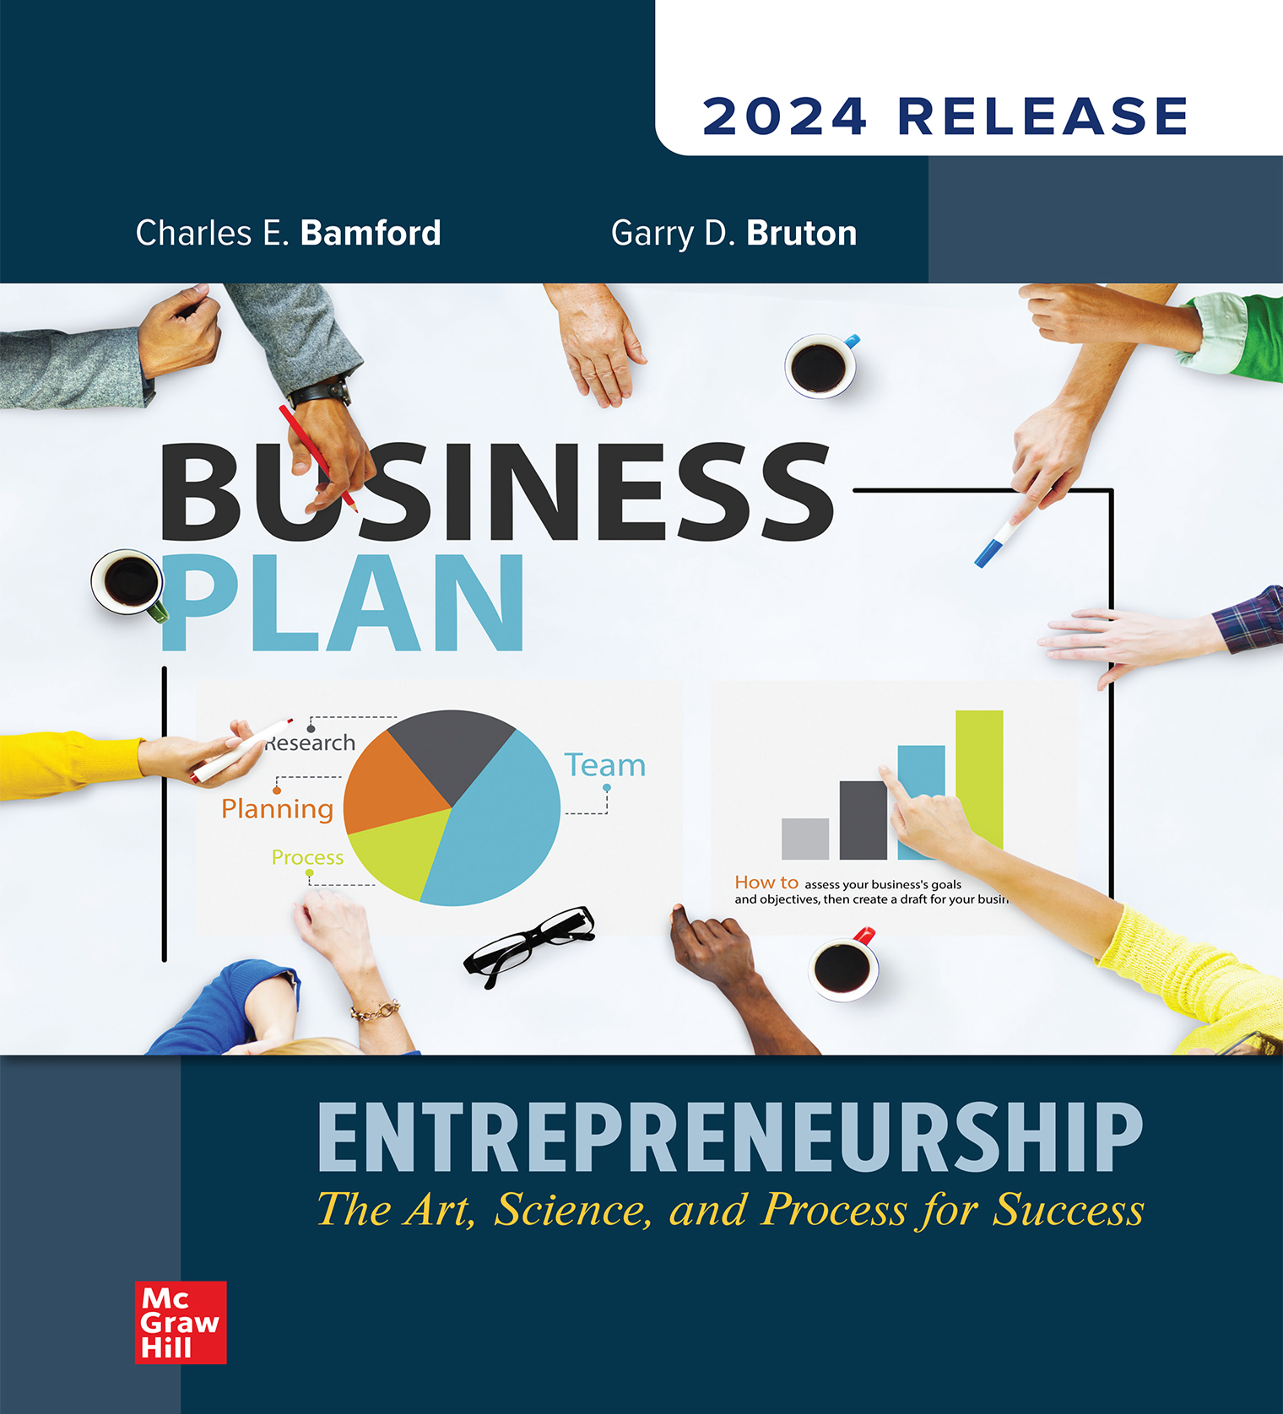
Chapter 2
Individual Leadership and Entrepreneurial Start-Ups
© McGraw Hill LLC. All rights reserved. No reproduction or distribution without the prior written consent of McGraw Hill LLC.
Notes:
Continuing Part One: Laying the Groundwork for Small Business is Chapter Two: Individual Leadership and Entrepreneurial Start-Ups.

Slide 2
Evaluating Your Entrepreneurial Orientation
Potential entrepreneurs need to consider a number of issues about themselves before starting a new business.
Risk tolerance.
Prior experience.
Personality orientation of the individual.
Notes:
Learning Objective 2-2: Discuss the importance of an entrepreneurial orientation.
There are a number of issues that potential entrepreneurs need to consider about themselves as they look at starting a new business. These issues will shape the entrepreneur’s analysis of the potential of any business idea. These include:
Risk tolerance
Prior experience
Personality orientation of the individual

Slide 3
Risk Tolerance
Entrepreneurs must evaluate:
Whether they have the risk tolerance to start a new business.
The level of risk they will accept in a given business situation.
It takes time for the business to reach the break-even point, where revenue sufficiently covers expenses.
Individual entrepreneurs must be aware of their risk tolerance and establish a business consistent with that tolerance.

Slide 4
Prior Experience
Experiences, history, culture, and family values:
Help individuals interpret the world.
Place boundaries on how individuals see the world.
Establish what people consider to be both possible and practical.
  Referred to as an individual’s bounded rationality.
  Often leading to pioneers being unrestricted by the past.
Their own version of rationality bounds individuals’ decision-making.
Notes:
Learning Objective 2-2: Discuss the importance of an entrepreneurial orientation.
The second element of entrepreneurial orientation is prior experience.
Our individual experiences, history, culture, and values not only help us interpret the world, but they also place boundaries on how we see that world.
They also establish what we consider to be both possible and practical. This is referred to as the individual's bounded rationality. It is the presence of bounded rationality that often leads young people to be pioneers in an area, as they are not limited by the restrictions of the past.
Bounded rationality is the reason individuals from outside an industry are able to establish a new business in a manner not previously considered.
Bounded rationality is the rational decision making that is constrained by the background and history of the person making the decision.
It is important for individuals to understand how their decision making is bounded by their own version of rationality.

Slide 5
Personality Orientation of the Individual
  Can be analyzed through established and validated personality tests.
  Myers-Briggs focuses on four pairs of variables.
    Extroversion-introversion, sensing-intuiting, thinking-feeling, and judgment-perception.
  Enneagram suggests that there are nine different types of personalities.
    Reformer, helper, achiever, individualist, investigator, loyalist, enthusiast, challenger, and peacemaker.
  Big Five Test looks at five factors.
    Open-mindedness, conscientiousness, agreeableness, emotional stability, and extroversion.
Notes:
Learning Objective 2-2: Discuss the importance of an entrepreneurial orientation.
The third element of entrepreneurial orientation is an examination of your own personality.
These tests should not be used to determine whether you are capable of starting a new business. Use these tests to help better understand yourself and your strengths, not as a guide for your career.
Myers-Briggs focuses on four pairs of variables:
Extroversion-introversion: Focus on outward world or internal.
Sensing-intuiting: How people gather information.
Thinking-feeling: How they make decisions.
Judgment-perception: Order versus flexibility.
The different potential arrangements of variables are believed to indicate the different ways that individuals deal with other people and their environments.
The Enneagram test assigns you to one of nine different types of personalities:
Reformer: Idealist/perfectionist.
Helper: Caring/good interpersonal skills.
Achiever: Competent/driven.
Individualist: Sensitive/dramatic.
Investigator: Cerebral/focused.
Loyalist: Committed/pessimistic.
Enthusiast: Fun-loving/impatient.
Challenger: Action oriented/cynical.
Peacemaker: Easygoing/passive aggressive.
The Big Five is a popular personality test in universities. It is composed of five factors:
Open-mindedness.
Conscientiousness.
Agreeableness.
Emotional stability.
Extroversion.
These are considered by many researchers to be the five key components of an individual’s personality.

Slide 6
Links to the Personality Tests
Myers-Briggs: Link: https://www.myersbriggs.org/my-mbti-personality-type/mbti-basics/
The Big Five Test: Link: https://www.outofservice.com/bigfive/
Notes:
Learning Objective 2-2: Discuss the importance of an entrepreneurial orientation.
If you are interested in taking any of these tests, here are links to free versions of each.
These links take you to external sources where you will find the two tests mentioned in the text.

Slide 7
Supports
There are supports and resources available to the entrepreneur.
No single support assures success.
Support and resources include:
Family.
Social networks.
Community.
Financial resources.
Like classic architecture, a solid business is built upon a variety of support systems.
Notes:
Family: (Double Edge Sword) - support, guidance, suggestions, and potential funding.
Understand the “POD” – support group you can trust
Social Networks: Can be a rich source of advice on forming a business and potential sources of funding.
Community: Small Business Administration Centers – Think Tanks – Business Incubators (rentable space with link minded people)

Slide 8
Resources
Incubators – Sonoma County
Entrepreneur incubators provide crucial support for startups, offering resources like mentorship, workspace, networking, and capital access to help businesses develop, scale, and commercialize ideas, with popular examples including Y Combinator (general tech) and university-affiliated ones like Berkeley SkyDeck

Slide 9
9 Deadly Sins of the New Product Introduction Model
Sin 1
  Assuming what the customer wants
  Don’t build anything based upon guesses

Slide 10
9 Deadly Sins of the New Product Introduction Model
Sin 2
  Don’t build based upon what you want
  “I know what features they want”
  It’s unknown that the feature appeals to customers.

Slide 11
9 Deadly Sins of the New Product Introduction Model
Sin 3
  Don’t be focused on launch date
  Make realistic time frames
  When so worried about end date, it creates anxiety and chaos in the process.

Slide 12
9 Deadly Sins of the New Product Introduction Model
Sin 4
  Don’t be too focused on execution
  In a hurry to just “Get it done”
  Versus… Test, and prove Hypothesis
    Learn – Adjust – Retest - Prove

Slide 13
9 Deadly Sins of the New Product Introduction Model
Sin 5
  Don’t presume and then Document (create business Plan)
  You will be asked how you – “validated”
  Manage flow with milestones - proof

Slide 14
9 Deadly Sins of the New Product Introduction Model
Sin 6
  Don’t confuse traditional job titles
  Be flexible with who you work with
  Have many hats filled by individuals

Slide 15
9 Deadly Sins of the New Product Introduction Model
Sin 7
  Feeling obligated to stick to the plan
  Don’t be – know you will adjust as you go
  Nothing is etched in stone
  Sales & Marketing process don’t get locked – adjust with client demand

Slide 16
9 Deadly Sins of the New Product Introduction Model
Sin 8
  Don’t presume success
  Once you launch – you need scalability
  Continue to build and constantly check your plan
  Make adjustments as necessary

Slide 17
9 Deadly Sins of the New Product Introduction Model
Sin 9
  Don’t manage by crisis
  Assuming the problem is just management
  Get to the root
  Avoid pointing the finger

Slide 18
Start – to - Finish
Your idea today may evolve to something completely different at the end of successful integration
The startup evaluation – process – development can often times provide a clearer path to something different.
FaceMash – Harvard – Zuckerberg: rate attractive students

